Slide 1
Lecture 10:
Remote Sensing
CEGE0096: Geospatial Programming
Dr. Aldo Lipani · Ilya Ilyankou (first-year PhD student)

Slide 2
What is Remote Sensing?
The science of obtaining information about objects or areas from a distance, typically from aircraft or satellites

Slide 3
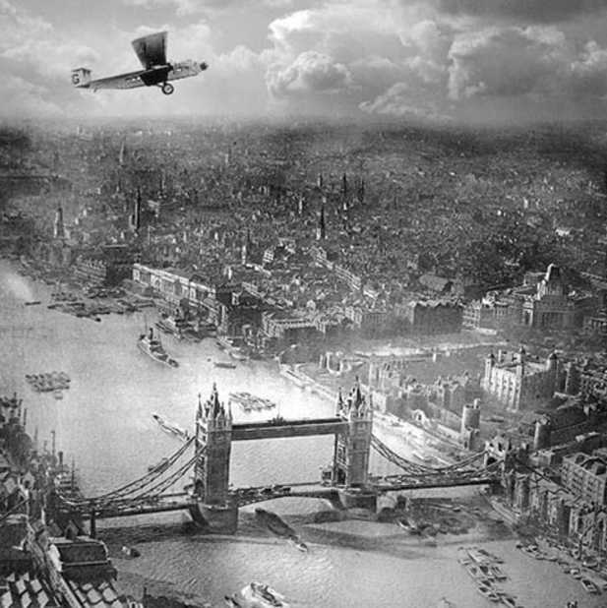
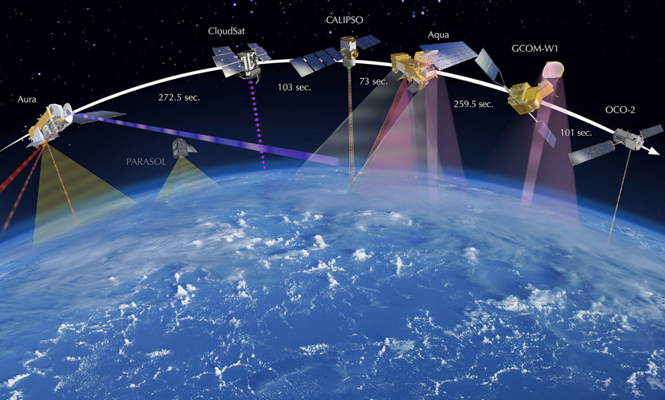
Brief history of remote sensing
Pre-Space Age (1800s-1957)
Post-Space Age (1957-)

Slide 4
Brief history of remote sensing (2)
Pre-Space Age (1800s-1957)
Photography (1800s)
First flight (early 1900s)
WWII (1939-1945)
Aerial photography is key military asset
Radar invented
Spy planes (U-2) during Cold War
Post-Space Age (1957-)
Sputnik 1 - first satellite launched by USSR (1957), followed by US’ Explorer 1 (1958)
5 other countries launch their first satellite in the next decade
US’ Landsat programme (1972-) for continuous Earth monitoring
Copernicus programme (EU; 2014-)

Slide 5

Copernicus Programme
Copernicus is the Earth observation component of the EU Space programme, launched in 2014
Collects and distributes timely global data about the atmosphere, land and sea from Sentinel and other satellites
The data is free and easily accessible

Slide 6
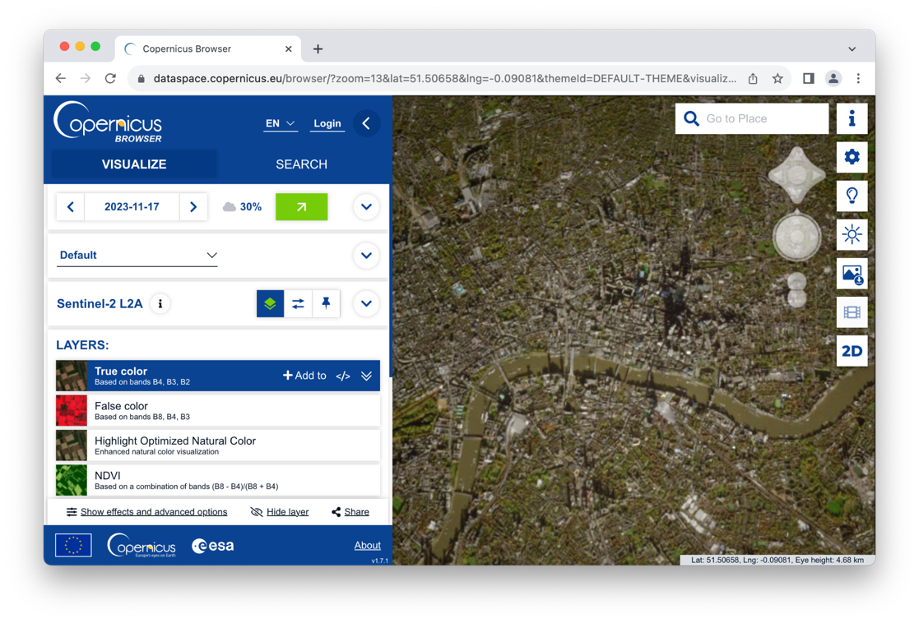
Copernicus Browser
You can use Copernicus Browser (DataSpace) to explore and download Copernicus imagery for any part of the world
New imagery available every 1-5 days depending on the programme
https://dataspace.copernicus.eu/browser/

Slide 7
Types of Remote Sensing Technologies

Slide 8
About electromagnetic radiation
The energy Earth receives from the sun is called electromagnetic radiation (EM)
Radiation is reflected, absorbed, and emitted by the Earth's atmosphere and surface
Radiation comes in different wave frequencies that form the electromagnetic spectrum
This includes visible light, as well as other waves not detected by human eye

Slide 9
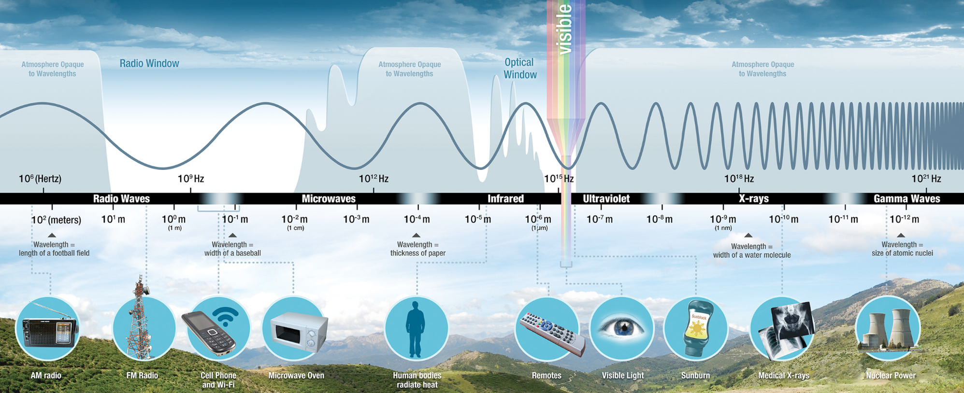
Electromagnetic spectrum
Illustration: NASA

Slide 10
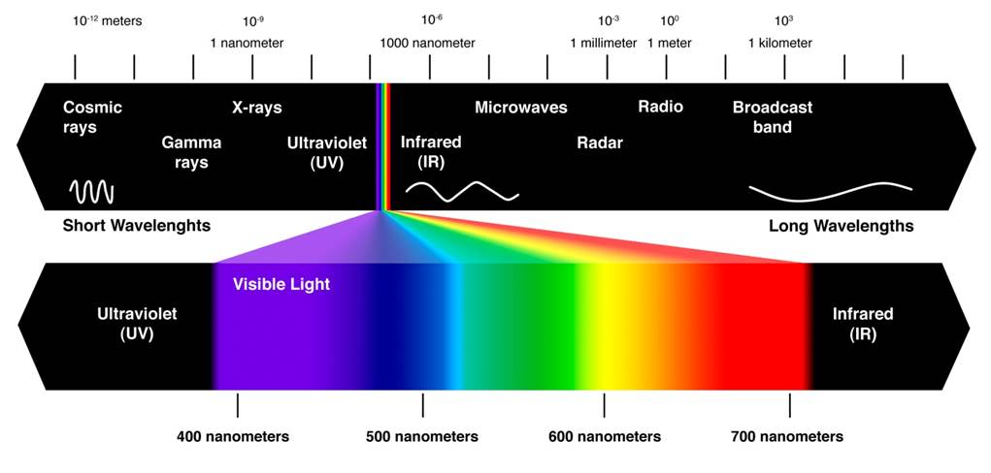
Visible light
Illustration: Wikimedia Commons
Notes:
https://upload.wikimedia.org/wikipedia/commons/a/a2/Visible_and_invisible_light.jpg

Slide 11
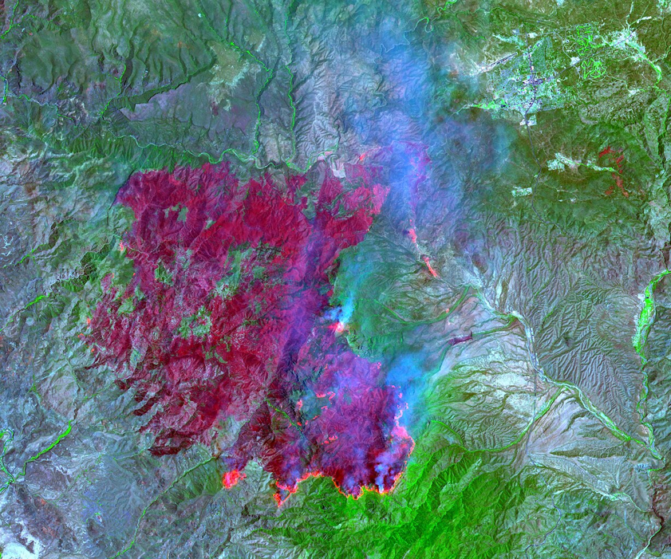
Infrared radiation
Sits between microwaves and visible light at ~750 nanometers to 100 micrometers
Invisible to human eye but can be detected by satellite sensors
Emitted by warm objects, so widely used to detect land and sea surface temperatures, forest fires and other hot objects
Notes:
https://upload.wikimedia.org/wikipedia/commons/thumb/8/87/Willow_Fire%2C_Arizona_%28ASTER%29.jpg/1228px-Willow_Fire%2C_Arizona_%28ASTER%29.jpg

Slide 12
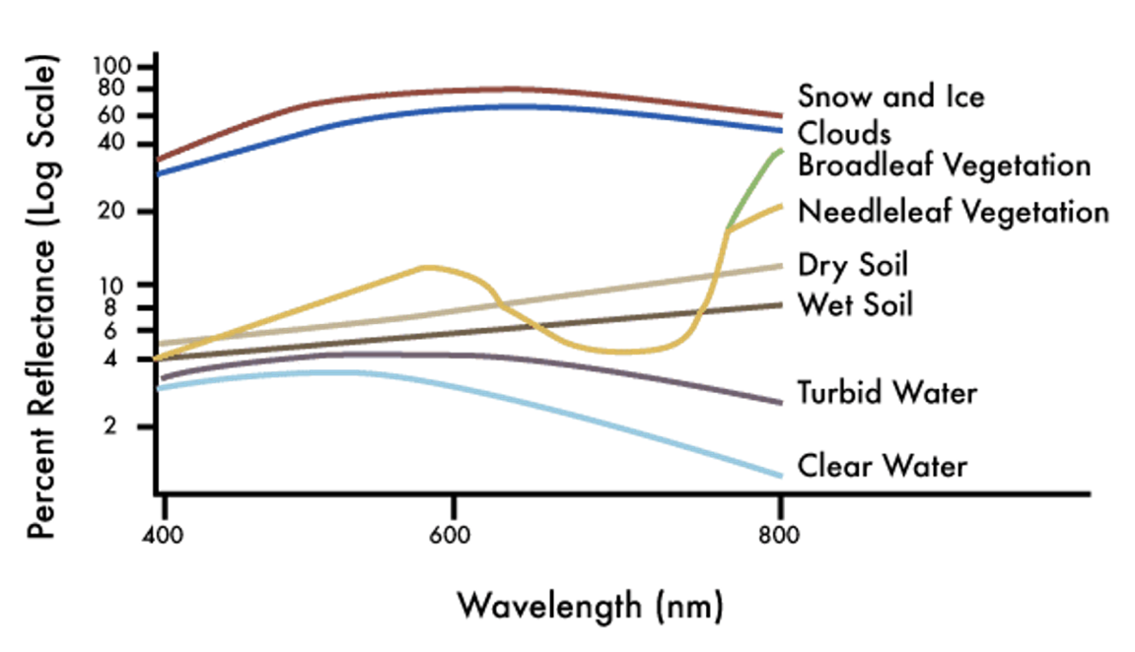
Spectral Signatures
Different materials reflect and absorb different wavelengths of EM radiation
You can record and plot reflected wavelengths detected by a sensor to get a “spectral signature” to identify the type of material it is reflected from
Illustration: NASA Applied Remote Sensing Training Program

Slide 13
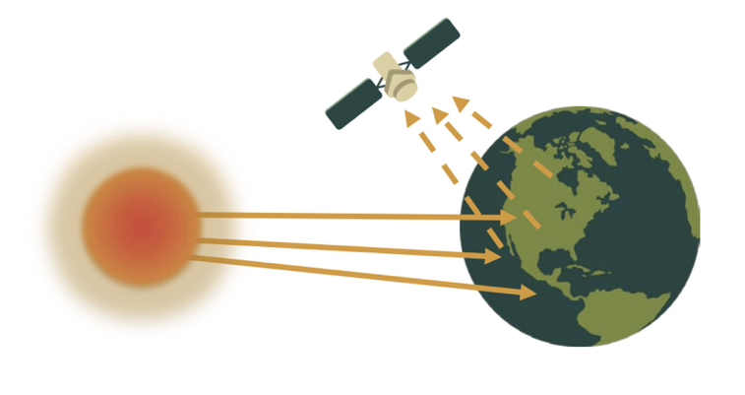
Passive sensors
Passive remote sensors measure radiant energy that is reflected by the atmosphere:
Normally operate in visible, infrared, thermal infrared, and microwave portions of the EM spectrum → usually cannot penetrate clouds
Used to measure land and sea surface temperature, vegetation properties, cloud and aerosol properties, and other physical attributes
Illustration: NASA Applied Remote Sensing Training Program

Slide 14
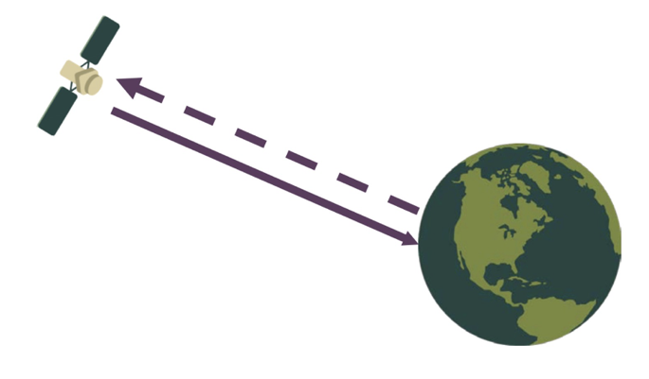
Active sensors
Active remote sensors provide their own energy source for illumination, typically in the microwave EM spectrum:
Able to penetrate through clouds as well as ‘see’ through the night
Useful to identify forest structure, precipitation and winds, sea surface topography, and ice
Examples: LiDAR, RADAR, Laser Altimeter
Illustration: NASA Applied Remote Sensing Training Program

Slide 15
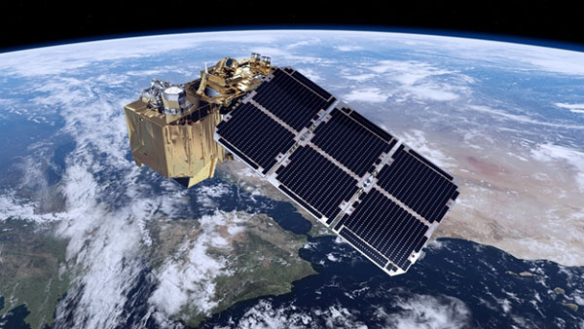
Multispectral sensors
Sensors monitor wavelengths in bands
Typically, we call sensors multispectral if they can measure values in 3 to 10-15 bands
Hyperspectral sensors are those that can observe 100s or 1000s of (narrower) bands. They have very high spectral resolution
Sentinel-2 (pictured) MultiSpectral Instrument samples 13 spectral bands at different spatial resolutions (4 at 10m, 6 at 20m, 3 at 60m)
Image: European Space Agency
Notes:
https://sentinel.esa.int/web/sentinel/user-guides/sentinel-2-msi/overview

Slide 16
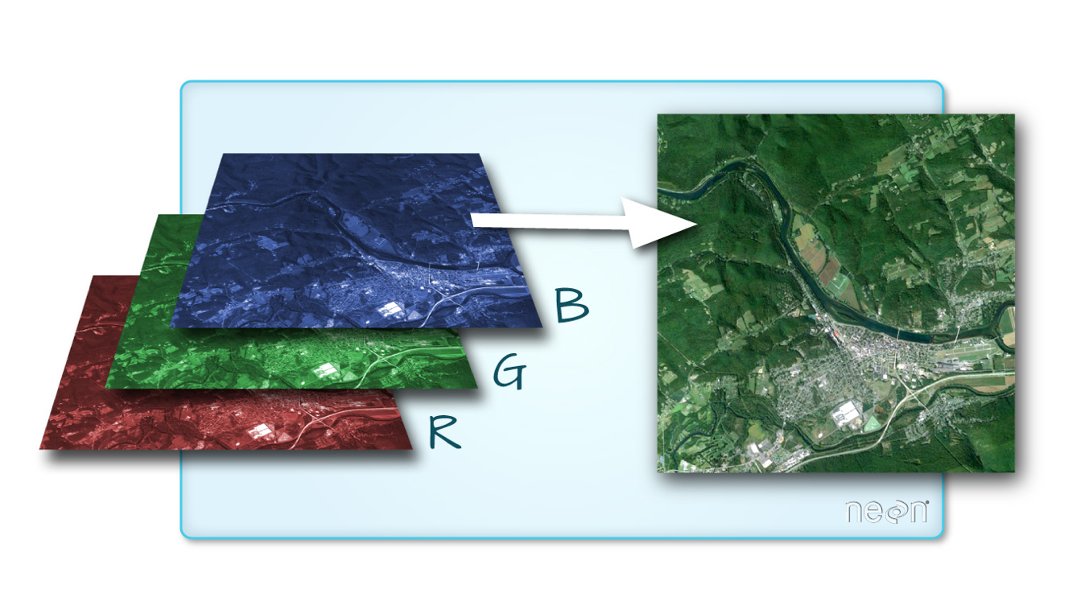
When added, Red, Green, and Blue wavelengths produce an image our eye is accustomed to
Illustration: Colin Williams, NEON
Notes:
https://www.earthdatascience.org/courses/use-data-open-source-python/multispectral-remote-sensing/intro-multispectral-data/

Slide 17
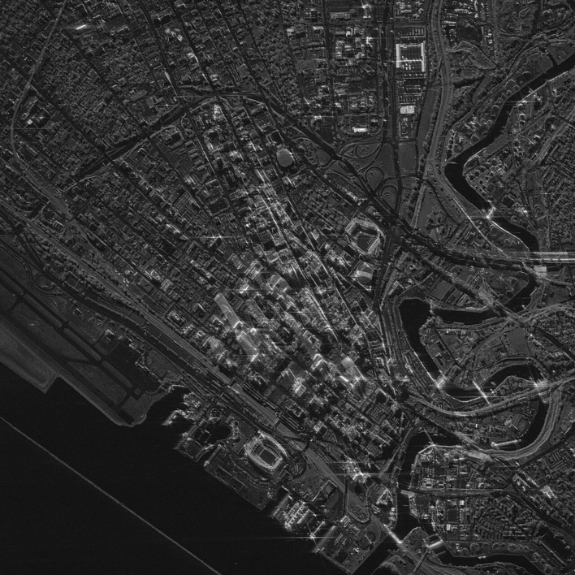
Radar and Synthetic Aperture Radar (SAR) sensors
Radar sensors are active sensors that use longer wavelengths (centimeter to meter scale)
Can “see” through the clouds unlike optical sensors. The longer the wavelengths, the better the object penetration
Sentinel-1A is the first satellite to provide free SAR imagery in 2014
SAR imagery of Cleveland, Ohio by Umbra
Notes:
https://www.earthdata.nasa.gov/learn/backgrounders/what-is-sar

Slide 18
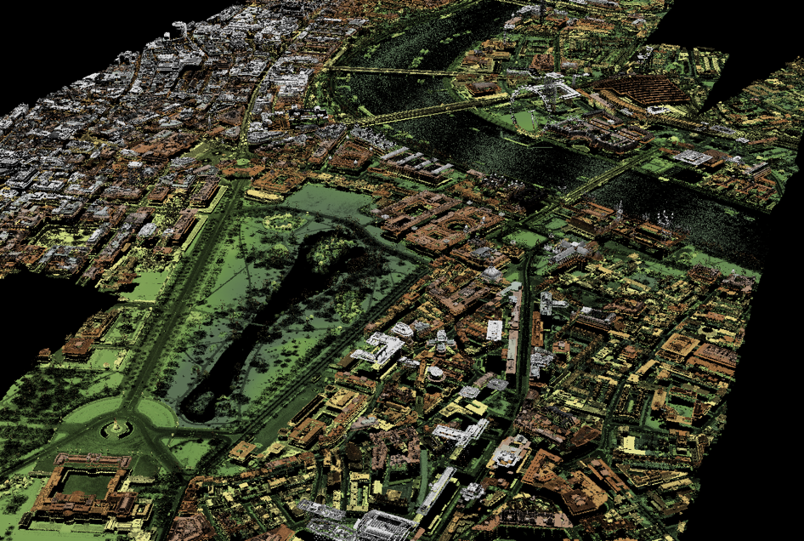
LiDAR sensors
“Light detection and ranging”
Targets objects with a laser and records how long it takes for the light to return (active sensors)
Usually installed on drones or planes
UK has produced 1m resolution LIDAR imagery for all of England - see https://digimap.edina.ac.uk/lidar

Slide 19
Data Acquisition and Platforms

Slide 20
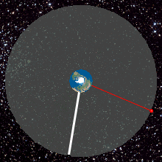
Satellites - Geostationary Orbit
Satellite flies above the equator at height of ~36,000km and follows the Earth’s rotation
Multiple daily observations
Limited spatial coverage (always the same observation area)
Typically communications and weather satellites
Notes:
https://en.wikipedia.org/wiki/Geostationary_orbit#/media/File:Geostationaryjava3D.gif

Slide 21
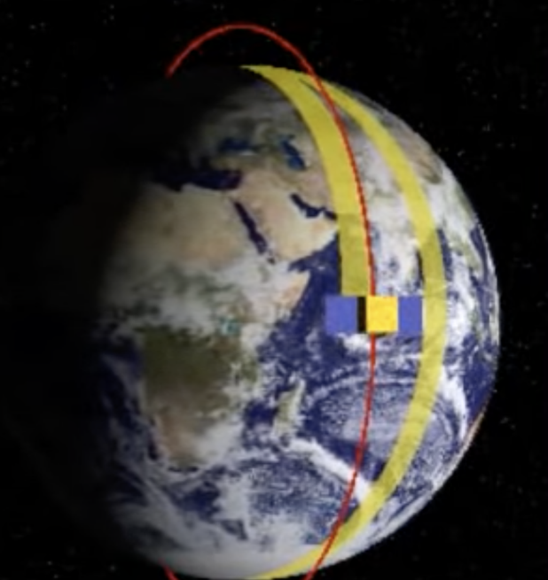
Satellites - Polar Orbit
Satellites pass above or nearly above both poles
Orbit is often Sun-Synchronous (SSO), meaning satellites pass same spot at same time of day (e.g. London at 2pm)
Typically fly at 700-800 km with orbital period of ~100 minutes producing global coverage in 1-30 days depending on how wide the observed path is
Applications in Earth mapping, reconnaissance (“spying”), sometimes weather
Notes:
https://en.wikipedia.org/wiki/Polar_orbit

Slide 22
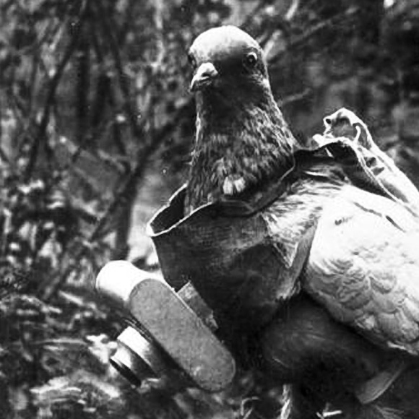
Aerial remote sensing
During WWI, Germans were flying pigeons with attached mini cameras! (pictured)
Today done using unmanned aerial vehicles (UAVs, or drones) and planes with attached sensors, such as cameras or LiDAR
For example, Historic England uses aerial photography to monitor the condition of heritage assets (both natural and man-made)
Notes:
https://en.wikipedia.org/wiki/Aerial_reconnaissance

Slide 23
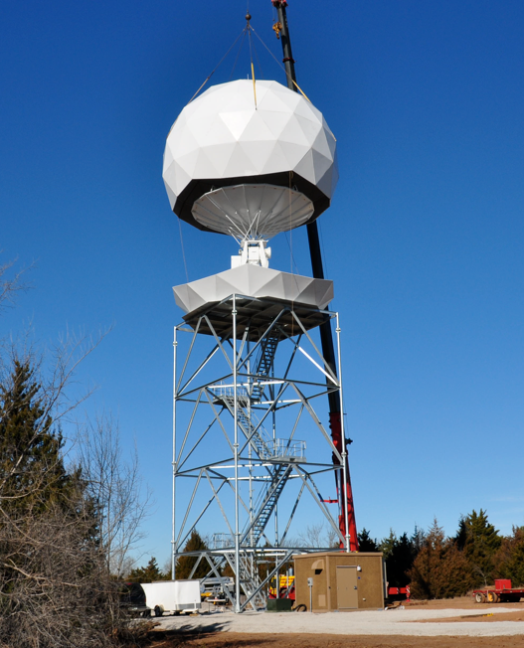
Ground-based stations
Cameras, ground vehicles, towers, cranes, buoys, boats… (Anything you can attach a sensor to)
Useful for frequent but local observations
Provide high resolution at small cost
Pictured is the weather radar OU-PRIME at the University of Oklahoma
Notes:
https://en.wikipedia.org/wiki/Weather_radar#/media/File:OUPRIME1.png

Slide 24
Remote Sensing in Data Science

Slide 25
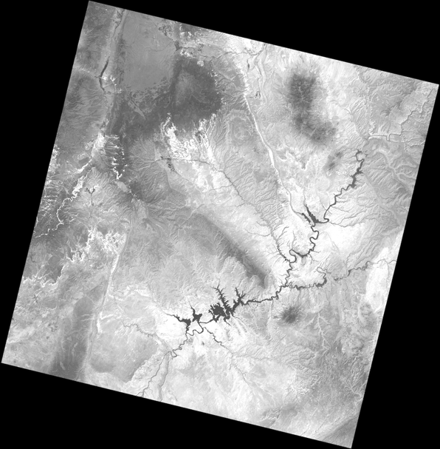
Raster files
Typically, remote sensing data comes in raster files
Raster files represent a (usually) square grid that is “mapped” to a real-world area at a particular resolution (for example, 1 cell = 30x30m). Most popular file format is GeoTIFF
Each cell has 1 or more numeric values associated with it. Imagery from multispectral sensors may come in multiple files, one for each band
The higher the spatial resolution, the larger the file
Notes:
https://rasterio.readthedocs.io/en/latest/quickstart.html

Slide 26
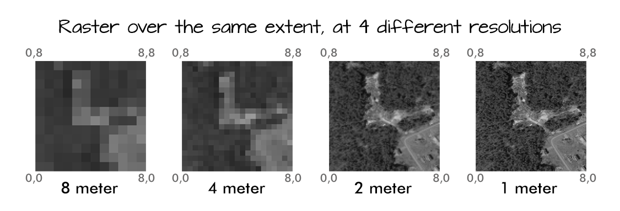
Spatial resolution example
Illustration: Colin Williams, NEON
Notes:
https://www.earthdatascience.org/courses/use-data-open-source-python/multispectral-remote-sensing/intro-multispectral-data/

Slide 27
Using rasterio to work with GeoTIFF files in Python
import rasterio
dataset = rasterio.open('example.tif')
dataset.width # returns width (in pixels)
dataset.height # returns height (in pixels)
dataset.count # returns number of bands
dataset.bounds # returns bounding box coords
dataset.crs # returns coordinate system

Slide 28
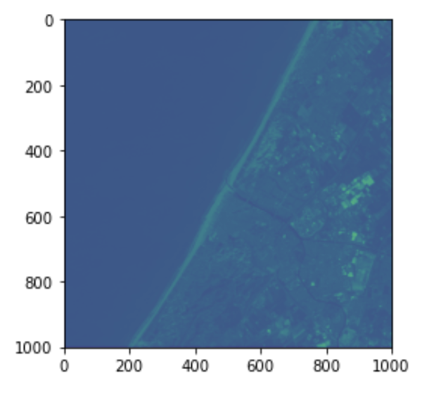
Using rasterio to work with GeoTIFF files in Python (2)
import matplotlib.pyplot as plt
print(dataset.count) # prints 3
# Read first band in 2D numpy array
band1 = dataset.read(1)
# Show rescaled values
plt.imshow( band1 ** (1/2) )

Slide 29
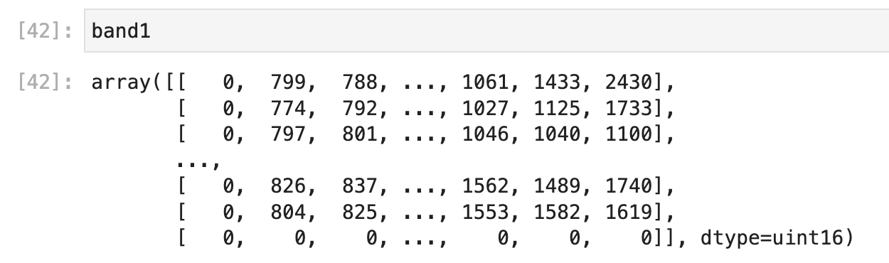
Using rasterio to work with GeoTIFF files in Python (3)
print(band1)

Slide 30
What to do with remote sensing imagery
Working with remote sensing images is largely working with 2D arrays (matrix algebra)
For example, we can calculate various Indices based on different band values for the same pixel to identify pixel properties
Or we could use pixel- and object-based algorithms to perform feature extraction, land cover classification and segmentation

Slide 31
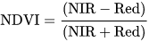
Identifying vegetation
If we have near-infrared (NIR) and Red band values, we can calculate Normalised Difference Vegetation Index (NDVI) to detect presence of vegetation in the study area
Note that thresholds are flexible and should be chosen based on task
Deserts, soil without vegetation would have low positive values (0.1-0.2)
Vegetation would have NDVI values of 0.3+ (denser canopy will have values of up to ~0.8)
Clouds and bodies of water may have negative values
Notes:
https://en.wikipedia.org/wiki/Normalized_difference_vegetation_index

Slide 32
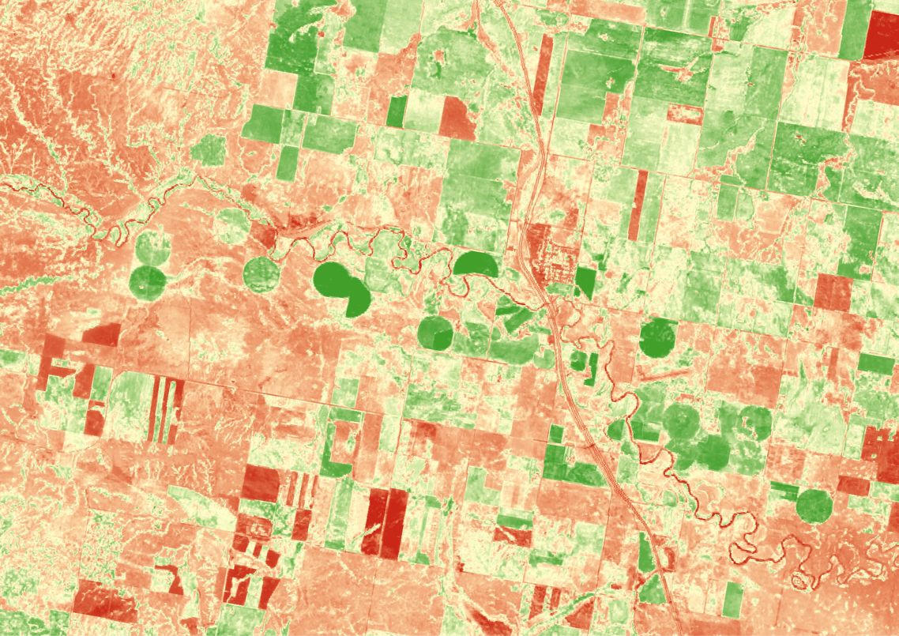
Identifying vegetation (2)
NDVI of the area along the Milk River in Alberta, Canada, 2016
Green is high NDVI values (vegetation), red is low NDVI values representing dry patches and bodies of water
Source: US Geological Survey
Notes:
https://www.usgs.gov/media/images/sentinel-2-alberta-ndvi

Slide 33
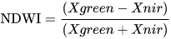
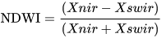
Identifying water
If we have near-infrared (NIR) and either short-wave infrared (SWIR) or green band values, we can calculate Normalised Difference Water Index (NDWI) to detect presence of water in the study area
Note that thresholds are flexible and should be chosen based on task
positive values represent “wet” features (0.5+ are bodies of water) Alternatively, values of 0.3+ represent water
Notes:
https://en.wikipedia.org/wiki/Normalized_difference_water_index

Slide 34
Classification in Remote Sensing
Unsupervised (Clustering)
Common clustering algorithms are K-Means and ISODATA
Labelling of clusters happens after classification, typically by a human expert
Clustering is traditionally done at pixel-level
Supervised (Classification)
We first create a training set of representative pixels with their relevant labels
We then pick an ML algorithm to perform classification, such as K-Nearest Neighbours, Logistic Regression, Random Forest, PCA, SVM…

Slide 35
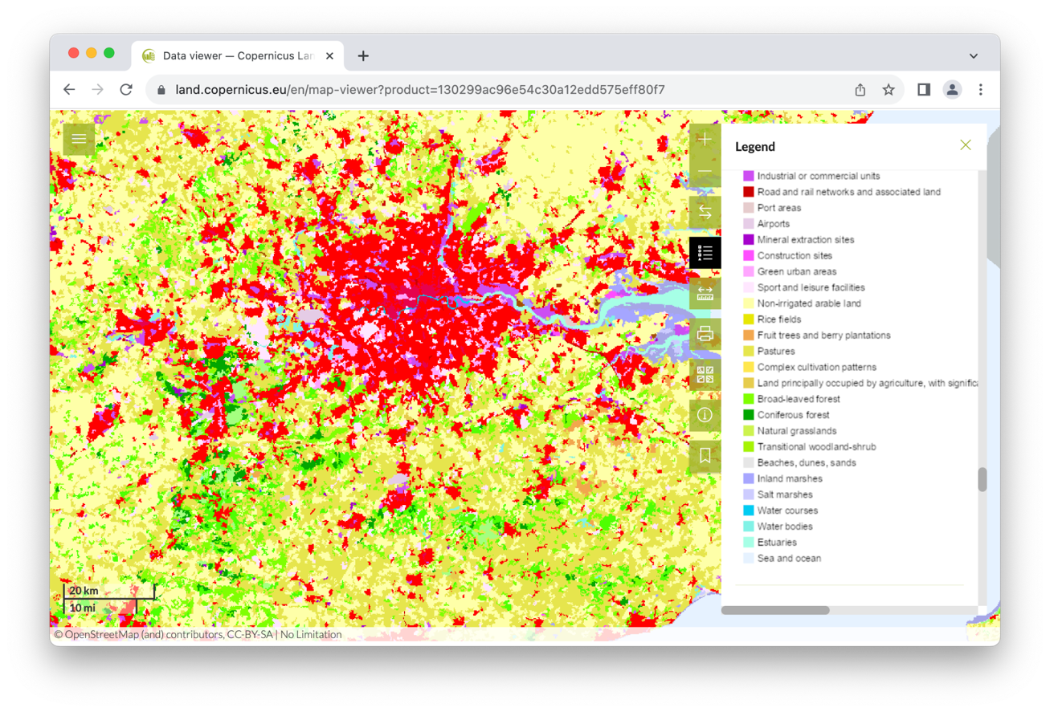
CORINE Land Cover
“CORINE Land Cover (CLC) product offers a pan-European land cover and land use inventory with 44 thematic classes, ranging from broad forested areas to individual vineyards”
Accessible via:
https://land.copernicus.eu/en/map-viewer

Slide 36
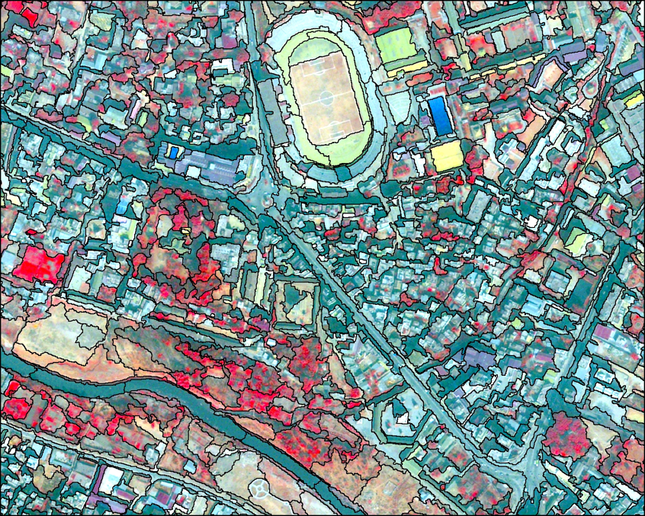
Object-Based Image Analysis (OBIA)
Supervised and unsupervised algorithm from the previous slide are both pixel-based
OBIA groups similar pixels into vector shapes using multi-resolution segmentation
You can choose to perform segmentation focusing on shape, texture, spectral signature
And classification is then performed on objects, not individual pixels
Notes:
https://en.wikipedia.org/wiki/Image_analysis#/media/File:Object_based_image_analysis.jpg

Slide 37
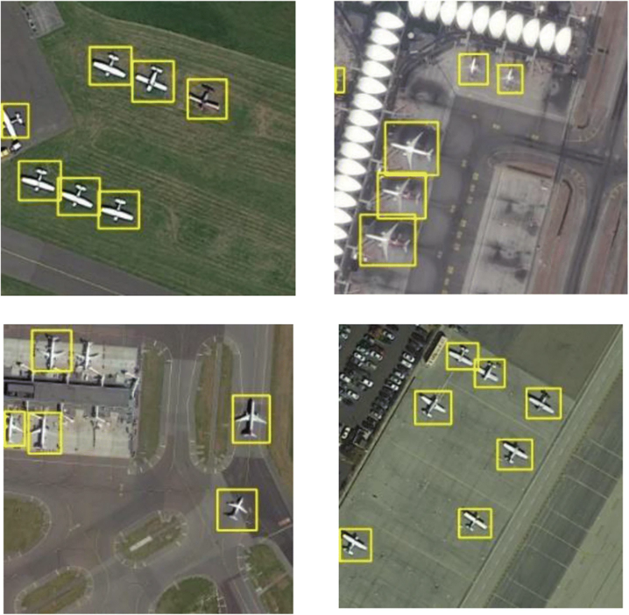
Object Detection Using ML/AI
To perform automatic object detection, algorithms based on Convolutional Neural Network architecture are often used
These include Region-based CNNs (R-CNNs), Faster R-CNNs, Mask R-CNN
You Only Look Once (YOLO)
Transfer learning (fine-tuning pre-trained image models on a small subset of new imagery) is also popular
Image: https://link.springer.com/article/10.1007/s11042-021-10833-z/figures/9
Notes:
Figure - https://link.springer.com/article/10.1007/s11042-021-10833-z/figures/9

Slide 38
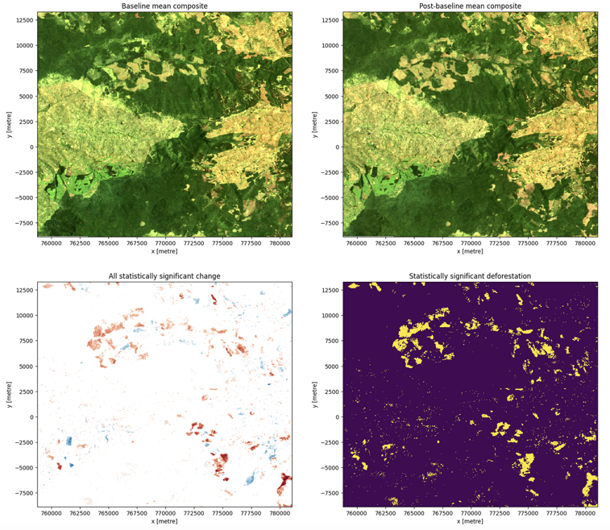
Change Detection Using ML/AI
Change detection can be as simple as finding the difference in band values between the two images, and reclassifying difference values as “change” (higher difference values) or “no change” (lower difference values)
Most algorithms for supervised pixel-based classification can be repurposed to detect pixel-based changes between images
Label pairs of pixels as ‘change’ or ‘no change’ between timestamps and let the ML decide
In addition to pixel-based, we can analyse changes at object-level (by first using object detection in imagery)
Notes:
https://docs.digitalearthafrica.org/en/latest/sandbox/notebooks/Real_world_examples/Vegetation_change_detection.html

Slide 39
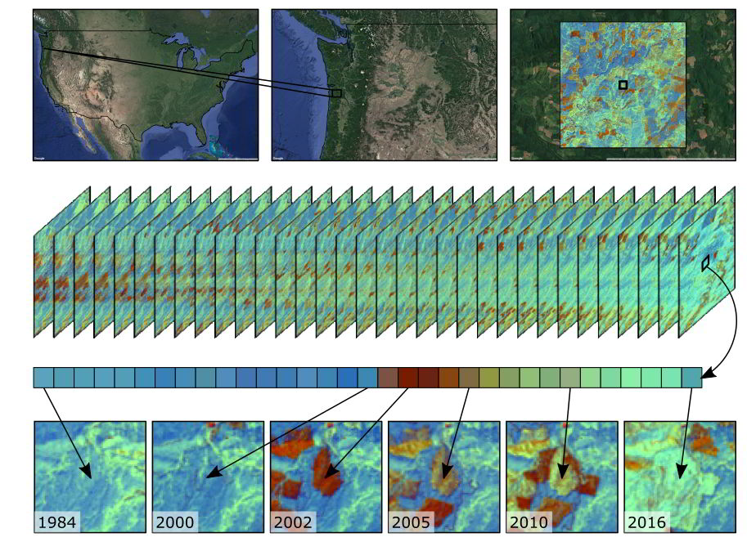
Time-Series Analysis of Remote Sensing Imagery
As we accumulate more remote sensing imagery, we can perform temporal analysis to detect various changes on the planet, from crops growing over the summer to coastal erosion and urbanisation processes
Much easier to compare imagery from the same observation programmes as sensors and resolution will be the same
Image: https://emapr.github.io/LT-GEE/landtrendr.html

Slide 40
Time-Series Analysis of Remote Sensing Imagery (2)
Extract values for each relevant band, for each relevant pixel from different time periods
Standardise pixel values between time periods
Ensure spectral fidelity between sensors (use calibrated surface reflectance values if possible)
Fill in gaps (good luck with the clouds!)
Resolve outliers
Smooth and “detrend” data if needed
Apply a relevant algorithm, for example
LandTrendr
Continuous Change Detection and Classification (CCDC)
Notes:
https://gis.unbc.ca/wp-content/uploads/2022/03/TimeSeries14march2comp.pdf

Slide 41
Intro to Google Earth Engine (GEE)

Slide 42
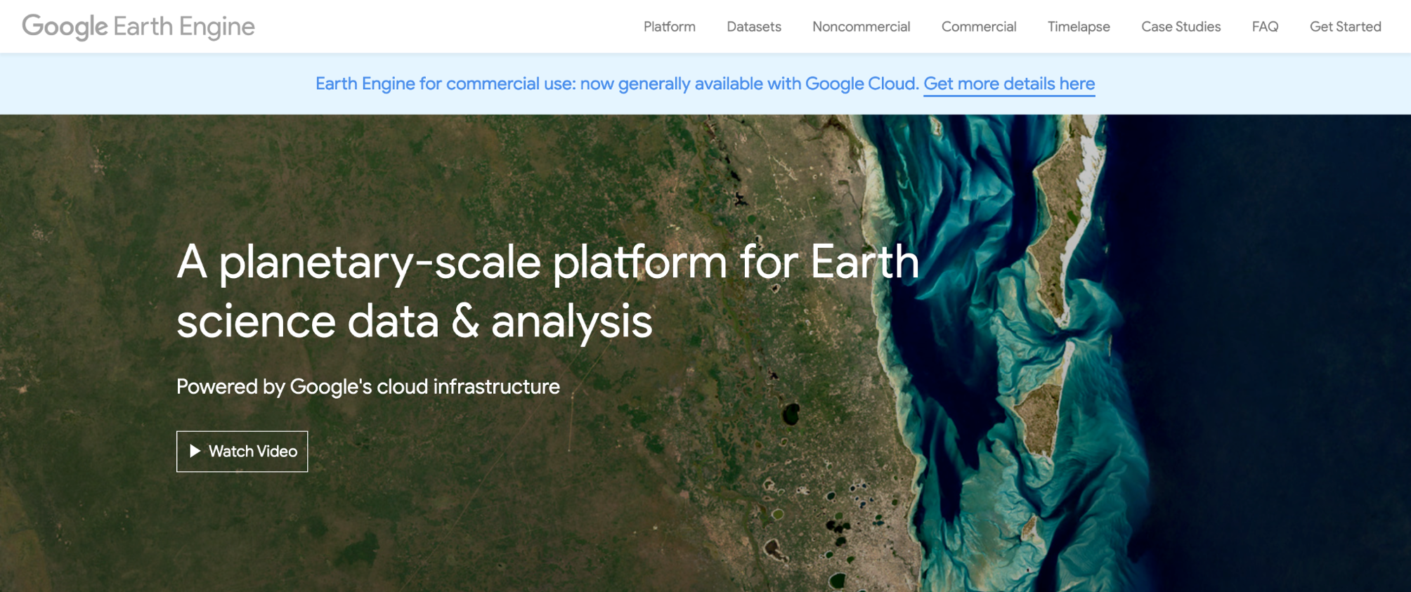

Slide 43
What is Google Earth Engine (GEE)?
Traditionally, working with GIS has been desktop-based. You find, download and analyse data locally on your machine
But it doesn’t work well when dealing with large files and computationally expensive ML algorithms, as you are likely to run out of RAM, or storage space, or patience
Google Earth Engine is one of the leading tools to work with remote sensing imagery at scale, fully in the cloud. It provides data + computational power

Slide 44
What makes GEE great?
Free for academic and non-profit use
A multi-petabyte catalogue of data (updated daily) that can be easily imported and analysed. This includes Landsat and Sentinel imagery, land use, historic weather data…
Built-in algorithms, from simple band arithmetics to ML tools
Expects code written in JavaScript, but provides a Python API

Slide 45
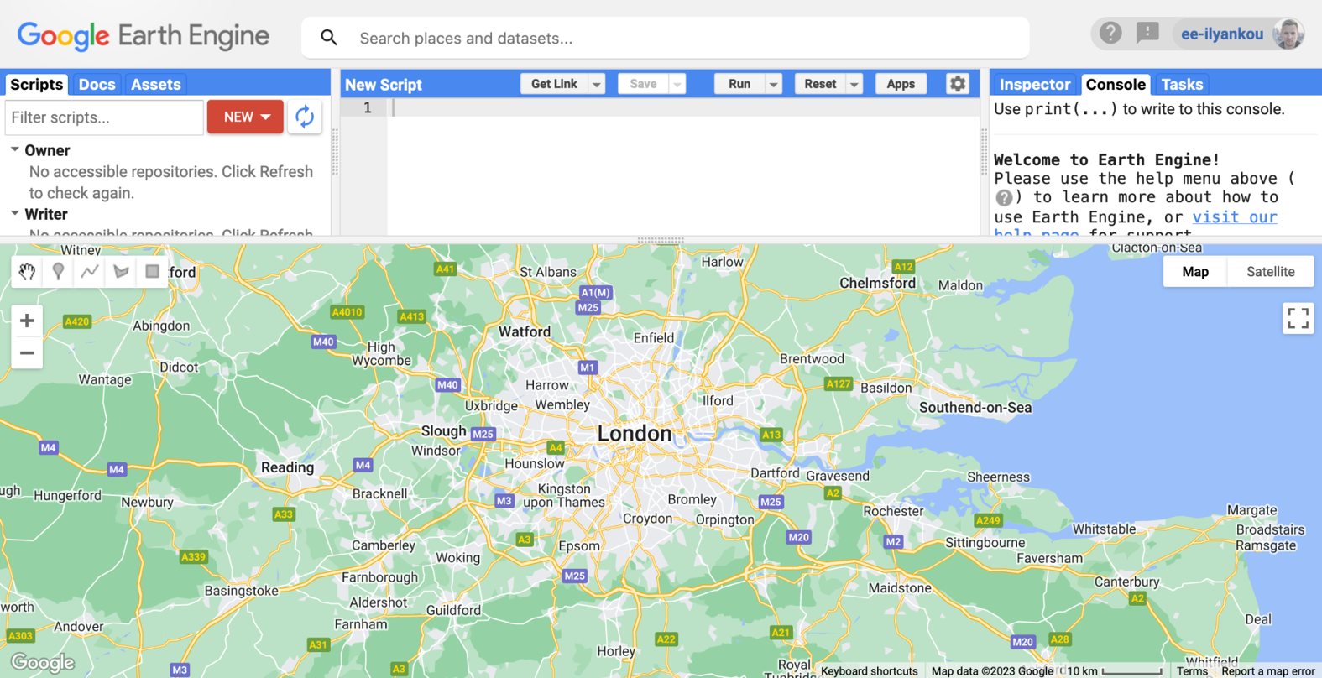
GEE Interface
search datasets here
write code here
create geometries (points, bounding boxes, etc) and view results here

Slide 46
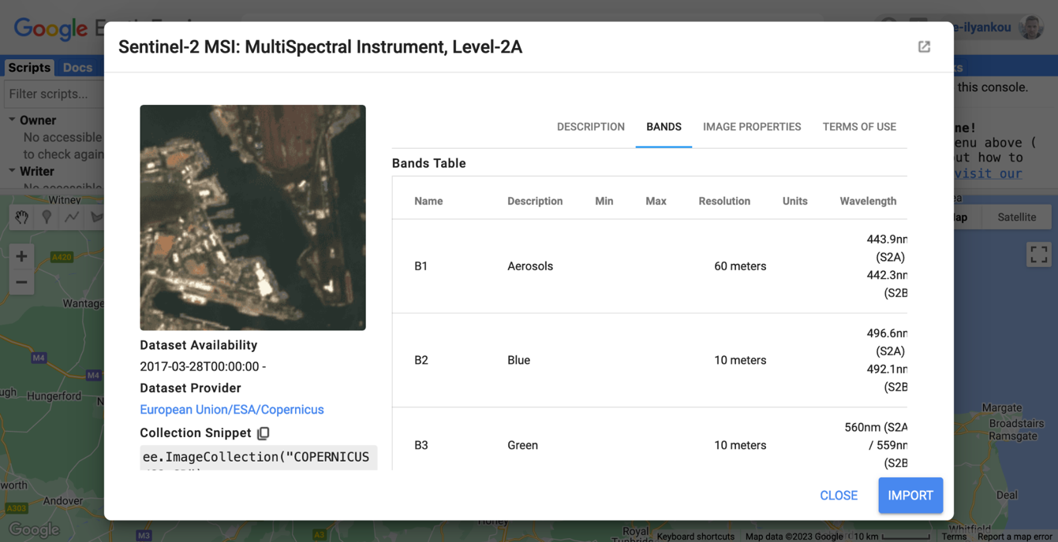
See dataset metadata in GEE

Slide 47
Create NDVI in GEE
// 1 - Import the relevant image collection (e.g. Sentinel 2, call it “landsat8”)
// 2 - Use "Add a marker" to create the anchor point (“centralLondon”)
var image = ee.Image(
landsat8.filterBounds(centralLondon)
.filterDate('2023-01-01', '2023-12-31')
.sort('CLOUD_COVER')
.first() // get least cloudy image in 2023
);
// Compute the Normalized Difference Vegetation Index (NDVI)
var nir = image.select('B5');
var red = image.select('B4');
var ndvi = nir.subtract(red).divide(nir.add(red)).rename('NDVI');
// Display the result.
Map.centerObject(image, 9);
var ndviParams = {min: -2, max: 2, palette: ['blue', 'white', 'green']};
Map.addLayer(ndvi, ndviParams, 'NDVI image');

Slide 48
Create NDVI in GEE (2)
// 1 - Import the relevant image collection (e.g. Sentinel 2, call it “landsat8”)
// 2 - Use "Add a marker" to create the anchor point (“centralLondon”)
var image = ee.Image(
landsat8.filterBounds(centralLondon)
.filterDate('2023-01-01', '2023-12-31')
.sort('CLOUD_COVER')
.first() // get least cloudy image in 2023
);
var ndvi = image.normalizedDifference(['B5', 'B4']).rename('NDVI');
// Display the result.
Map.centerObject(image, 9);
var ndviParams = {min: -2, max: 2, palette: ['blue', 'white', 'green']};
Map.addLayer(ndvi, ndviParams, 'NDVI image');

Slide 49
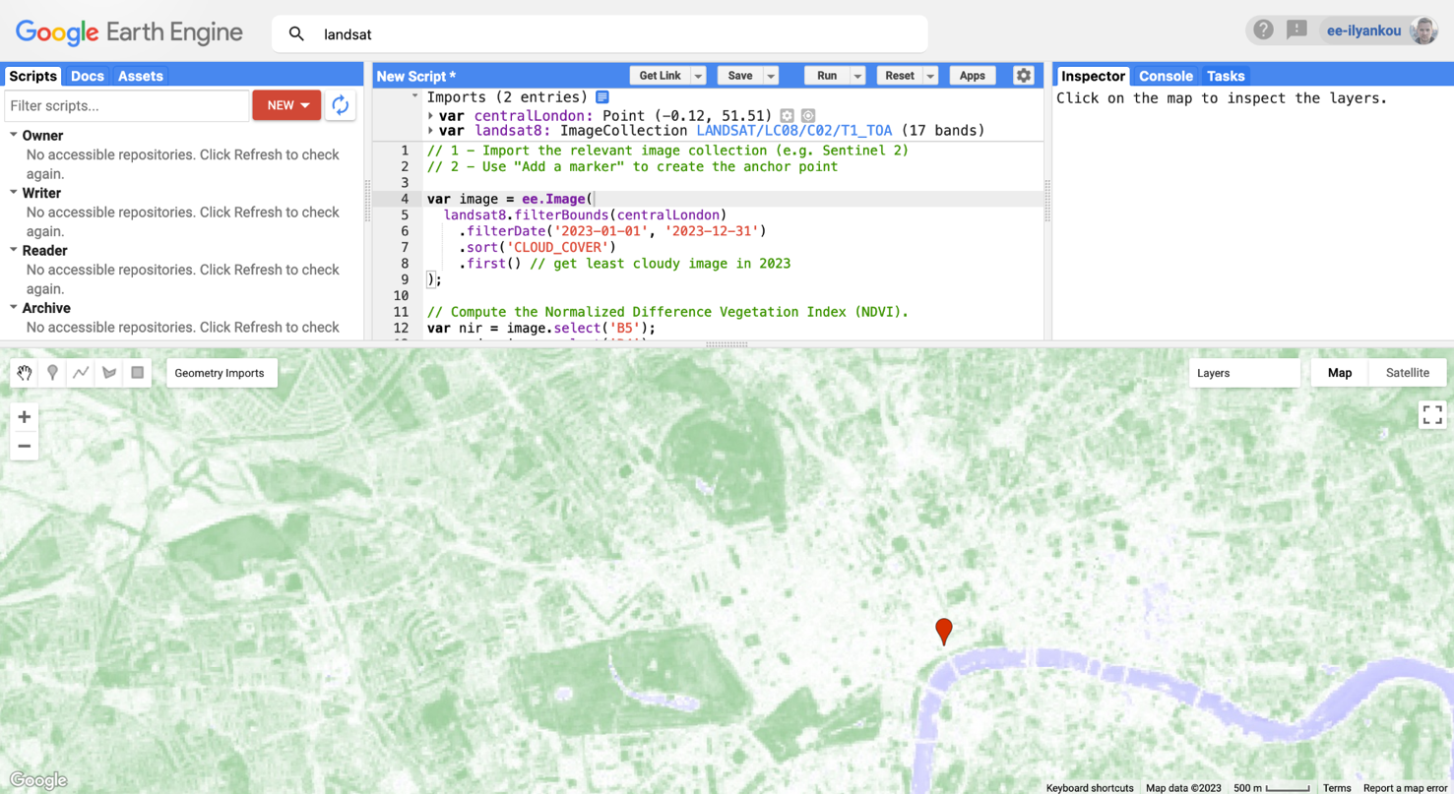
Create NDVI in GEE (3)

Slide 50
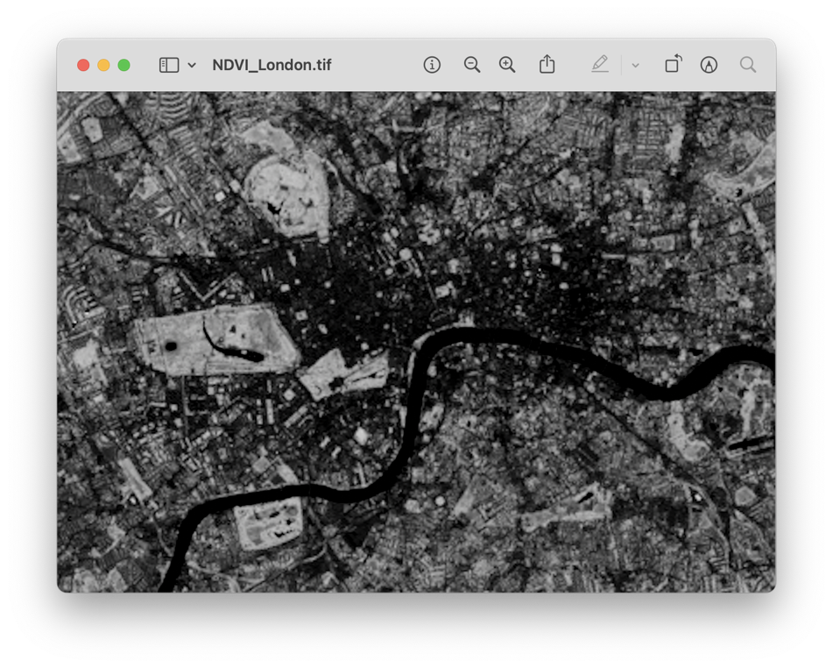
Export as GeoTIFF from GEE
Using GUI, create a new bounding polygon called centralLondonPoly
Run the following to generate an image to GDrive:
Export.image.toDrive({
image: ndvi,
description: 'NDVI_London',
scale: 30, // metres per pixel
region: centralLondonPoly
});

Slide 51
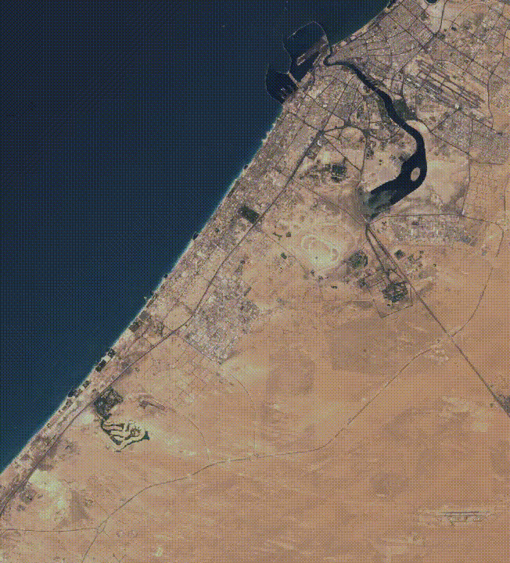
Create a timelapse in GEE
var allImages = ee.ImageCollection('LANDSAT/LE07/C02/T1_RT_TOA')
.filter(ee.Filter.eq('WRS_PATH', 160))
.filter(ee.Filter.eq('WRS_ROW', 43))
.filter(ee.Filter.lt('CLOUD_COVER', 30))
.filterDate('2000-01-01', '2023-12-30')
.select(['B3', 'B2', 'B1'])
.map(function(image) {
return image.multiply(512).uint8();
});
Export.video.toDrive({
collection: allImages,
description: 'dubaiTimelapse',
dimensions: 720,
framesPerSecond: 8,
region: ee.Geometry.Rectangle([55.1, 25.0, 55.4, 25.3])
});

Slide 52
Applications of Remote Sensing

Slide 53
Agriculture 🌾
Crop health monitoring
Vegetation indices (NDVI, NVI) help track health of crops and identify areas of disease or vegetation stress
Can help predict yield
Precision agriculture
Crop type mapping
Optimised irrigation (water only where and when needed)
Nutrient management

Slide 54
Environmental monitoring 🌳
Deforestation
Using change detection in vegetation indices to track areas of declining vegetation
Identify forest fires and areas of illegal logging
Urbanisation
Classify land use, track changes in urban sprawls
Estimate population and predict future growth in places with unreliable census
Glacier retreat
Using time-series analysis of satellite imagery to map ice cover to help make sense of global warming

Slide 55
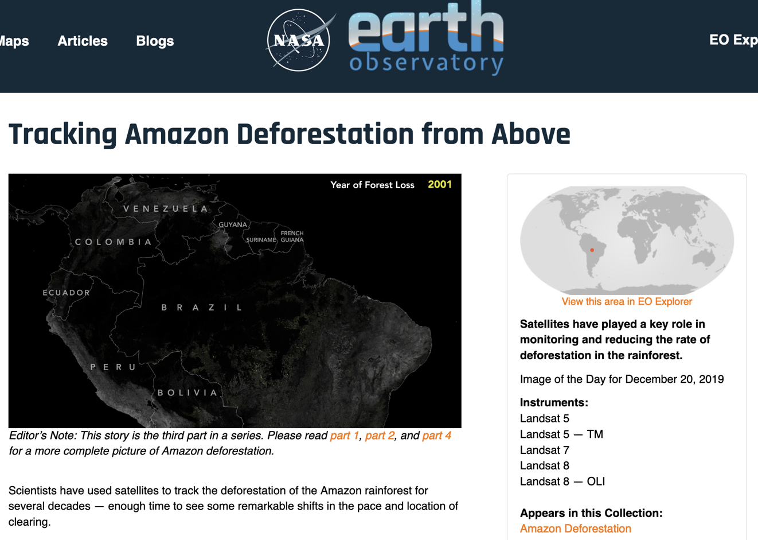
Deforestation of the Amazon rainforest is a well-researched subject that makes extensive use of remote sensing imagery
Source: NASA Earth Observatory
Notes:
https://earthobservatory.nasa.gov/images/145988/tracking-amazon-deforestation-from-above

Slide 56
Disaster management: Flood, wildfire, and hurricane tracking and prediction ☄️
Most types of early warning systems rely on remote sensing data to monitor phenomena (weather, river levels…) to predict destructive outcomes
Remote sensing can help assess damage, and facilitate planning of emergency response
Map floodplains using digital elevation models
Monitor sea surface temperature, wind and atmospheric conditions to predict development of hurricanes
Track and predict the movement of hurricanes to minimise casualties
Use vegetation index to identify drier areas that are more prone to wildfires
Identify existing fires and smoke using thermal infrared sensors to alert local emergency services

Slide 57
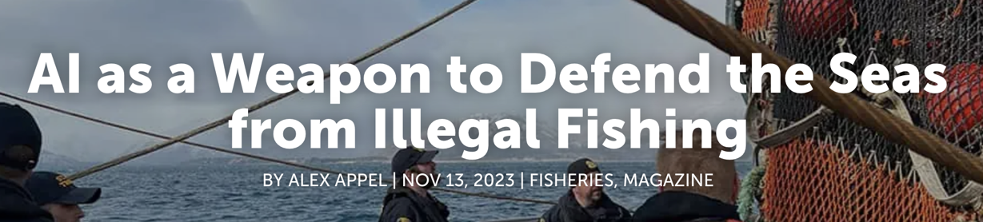
In 2022, the US Department of Defence ran the xView 3 Challenge (https://iuu.xview.us/), a $150,000 competition to detect dark vessels using computer vision and global SAR satellite imagery. The winners (individuals and organisations) were announced on 31 January 2022.
“After the [SAR] images are collected, machine learning algorithms paint a detailed picture: where vessels are, how large they are, what they are doing and, based on that information, what are the odds that they are engaging in illegal activity”.
Source: https://www.akbizmag.com/industry/fisheries/illegal-fishing-ai/
Notes:
https://iuu.xview.us/ https://www.diu.mil/latest/xview3-winners-announced

Slide 58
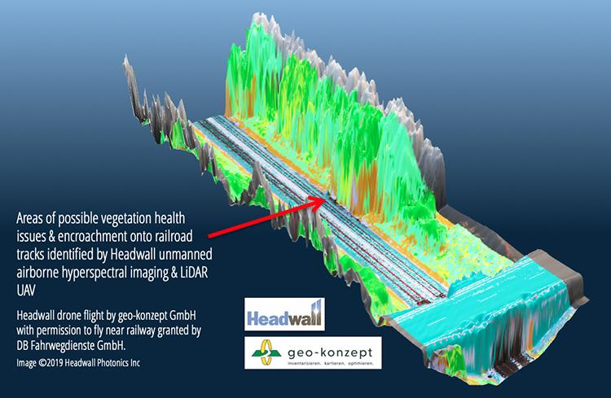
Urban planning and infrastructure development 🏙️
Use satellite imagery to perform land use segmentation and track urban expansion using change detection
Identify suitable sites for large infrastructure projects by looking at terrain, population, and land cover
Monitor infrastructure health using satellite imagery, LiDAR data, and “digital twins”
Image: Identifying vegetation and positions of potentially at-risk trees adjacent to the railway, Headwall BVBA + geo-konzept
Notes:
https://www.impopen.com/blog/headwall-centre-hyperspectral-remote-sensing-europe

Slide 59
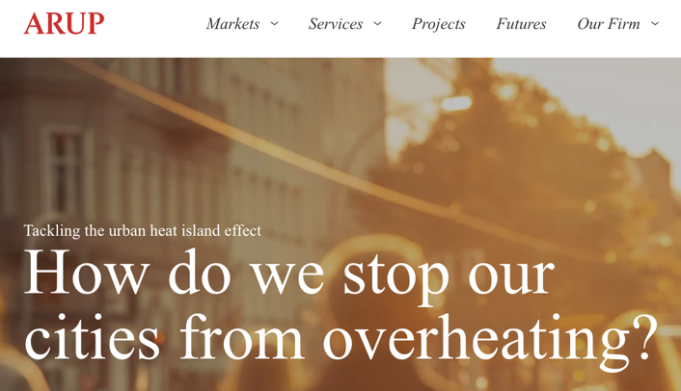
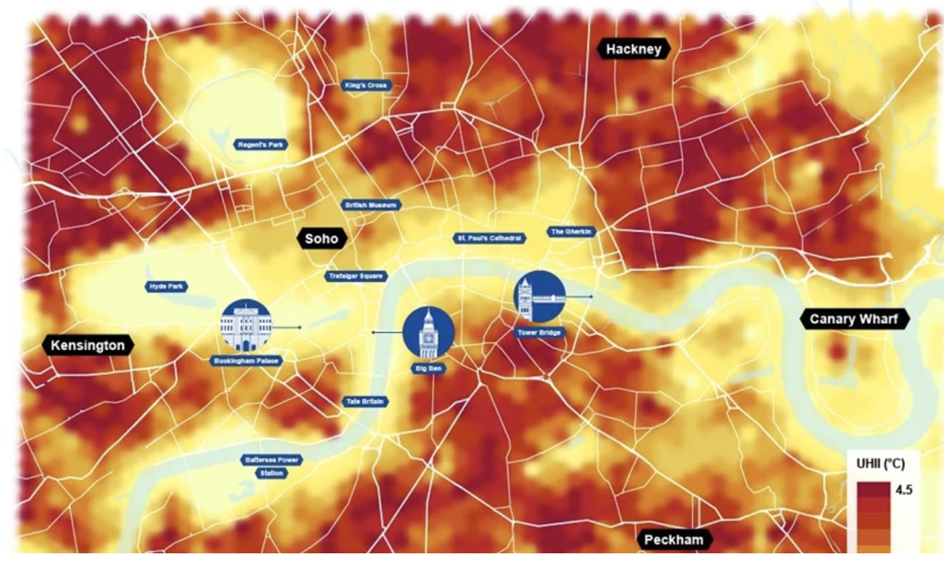
Arup’s Urban Heat Snapshot report, which used AI + satellite images to perform heat modelling (UHeat)
Notes:
https://www.arup.com/perspectives/publications/research/section/urban-heat-snapshot

Slide 60
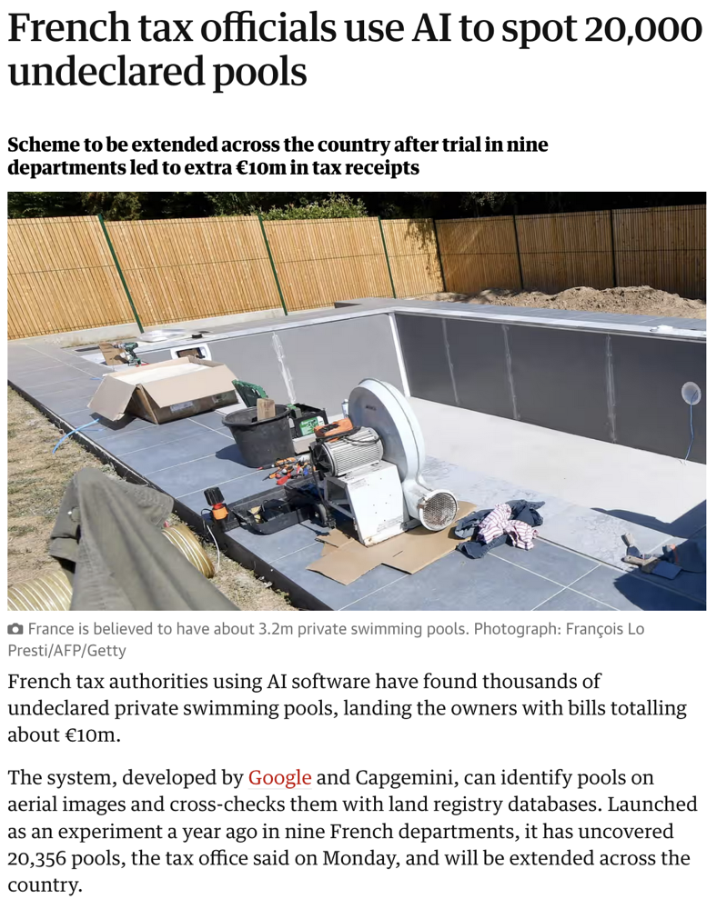
French tax authorities used aerial imagery to identify swimming pools (=simple object detection), then cross-check those with the land registry database, and identify those built without permit
Source: Guardian, 29 August 2022
Notes:
https://www.theguardian.com/world/2022/aug/29/french-tax-officials-use-ai-to-spot-20000-undeclared-pools

Slide 61
Challenges and Considerations in Remote Sensing

Slide 62
Data volume and storage
We employ more sensors, constantly improving their spatial and temporal resolution → a lot more data that is being captured
The move from desktop GIS to cloud-first GIS should eliminate this issue, but it comes at a cost, as well as privacy concerns
In addition to storage, there are issues with data transfers and bandwidth (how to quickly move data from a distant sensor), data redundancy and security concerns
Can we design “smart” sensors that do most of the processing and output the relevant data only (“edge computing”)?

Slide 63
Cloud cover and atmospheric interference
A lot of places are difficult to monitor well due to cloud cover, which is physically impossible to penetrate for shorter waves (think: visible light, red/green/blue)
“Missing” values need to be modelled or inferred
Atmosphere absorbs some EM radiation (for example, ultraviolet radiation is almost entirely blocked by ozone), but does so unevenly depending on atmospheric composition → needs sophisticated algorithms to ‘clean’ values
This is usually done by data providers but may be done inconsistently
Notes:
https://www.esa.int/SPECIALS/Eduspace_EN/SEMUYP3Z2OF_0.html

Slide 64
Ethical considerations: Privacy, surveillance, and geopolitical concerns
As spatial and temporal resolution of the satellites increases, to what extent should satellites of one country be allowed to collect data on private property and activities of residents of another country?
Where should remote sensing imagery be stored, and how should it be protected?
Should we keep or destroy old and/or “unnecessary” data?

Slide 65
References
NASA ARSET, Fundamentals of Remote Sensing - https://appliedsciences.nasa.gov/sites/default/files/2022-11/Fundamentals_of_RS_Edited_SC.pdf
NASA EarthData - https://www.earthdata.nasa.gov/
UBC GEOB373, History of Remote Sensing Lecture - https://ibis.geog.ubc.ca/courses/geob373/lectures/Handouts/lecture02.pdf
Alexandre Bevington, Time series analysis in Remote Sensing - https://gis.unbc.ca/wp-content/uploads/2022/03/TimeSeries14march2comp.pdf
GISGeography, OBIA - Object-Based Image Analysis (GEOBIA) - https://gisgeography.com/obia-object-based-image-analysis-geobia/
OSU eMapR Lab - https://emapr.github.io/LT-GEE/landtrendr.html

